Slide 1

Data Manipulation in R - Part 1
September 5, 2020
11:00 am - 1:00 pm

Slide 2
Time | Activity | Speaker/Moderator
11:00 am – 11:10 am | Participants joining
11:10 am – 11:15am | Welcoming remarks and introducing the speaker | Lucy Njuki
11:15 am – 11:30 am | Session 1: Introduction to R | Naomi Ng’ang’a
11:30 am – 11:40 am | Practical exercise | Naomi Ng’angá assisted by R-Ladies Nairobi organisers
11:40 am – 12:20 pm | Session 2: Data management | Naomi Ng’angá
12:20 pm – 12: 40pm | Practical exercise | Naomi Ng’angá assisted by assisted by R-Ladies Nairobi organisers
12:40 pm – 12:50 pm | Questions and feedback | Naomi Ng’ang’a & Lucy Njuki
12:50 pm – 1:00 pm | Closing remarks | Lucy Njuki

Slide 3

Our trainer
Naomi Ng’ang’a
Data analytics and visualization officer - International Centre for Humanitarian Affairs(ICHA) - Kenya Redcross

Slide 4
Session 1: Introduction to R
R Basic Syntax i.e. creating objects in R, vectors and data frames.

Slide 5
Practical Exercise

Slide 6
Session 2 : Data manipulation in R
Data management: creating a working directory, installing and loading packages, reading in data, creating variables, renaming variables, selecting, subsetting data, checking for duplicates, dropping or keeping variables, sorting, summarizing data.

Slide 7
Practical Exercise

Slide 8
Questions and feedback
Please, post your questions and feedback on the chat.

Slide 9
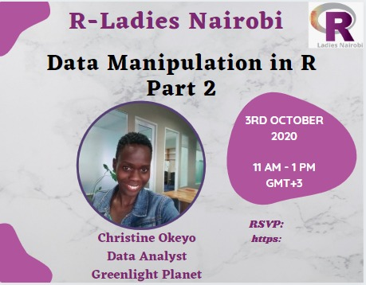

Slide 10
THANK YOU
Email address: nairobi@rladies.org
LinkedIn: R-Ladies Nairobi
Twitter: @RLadiesNairobi
Meetup: https://www.meetup.com/rladies-nairobi/

